Slide 1

Team Name: EquiSaaS BD
Team Leader Name: Kholipha Ahmmad Al-Amin (kholifaahmadalamin@gmail.com)
Team Member: Jannatul Nayeem (jannatulnayeemdev@gmail.com)
Team Size: 2 Members
Problem Statement: Intelligent Workflow Automation Agents
Project: Cortex-SupplyGuard (Autonomous Supply Chain Resilience Agent)

Slide 2
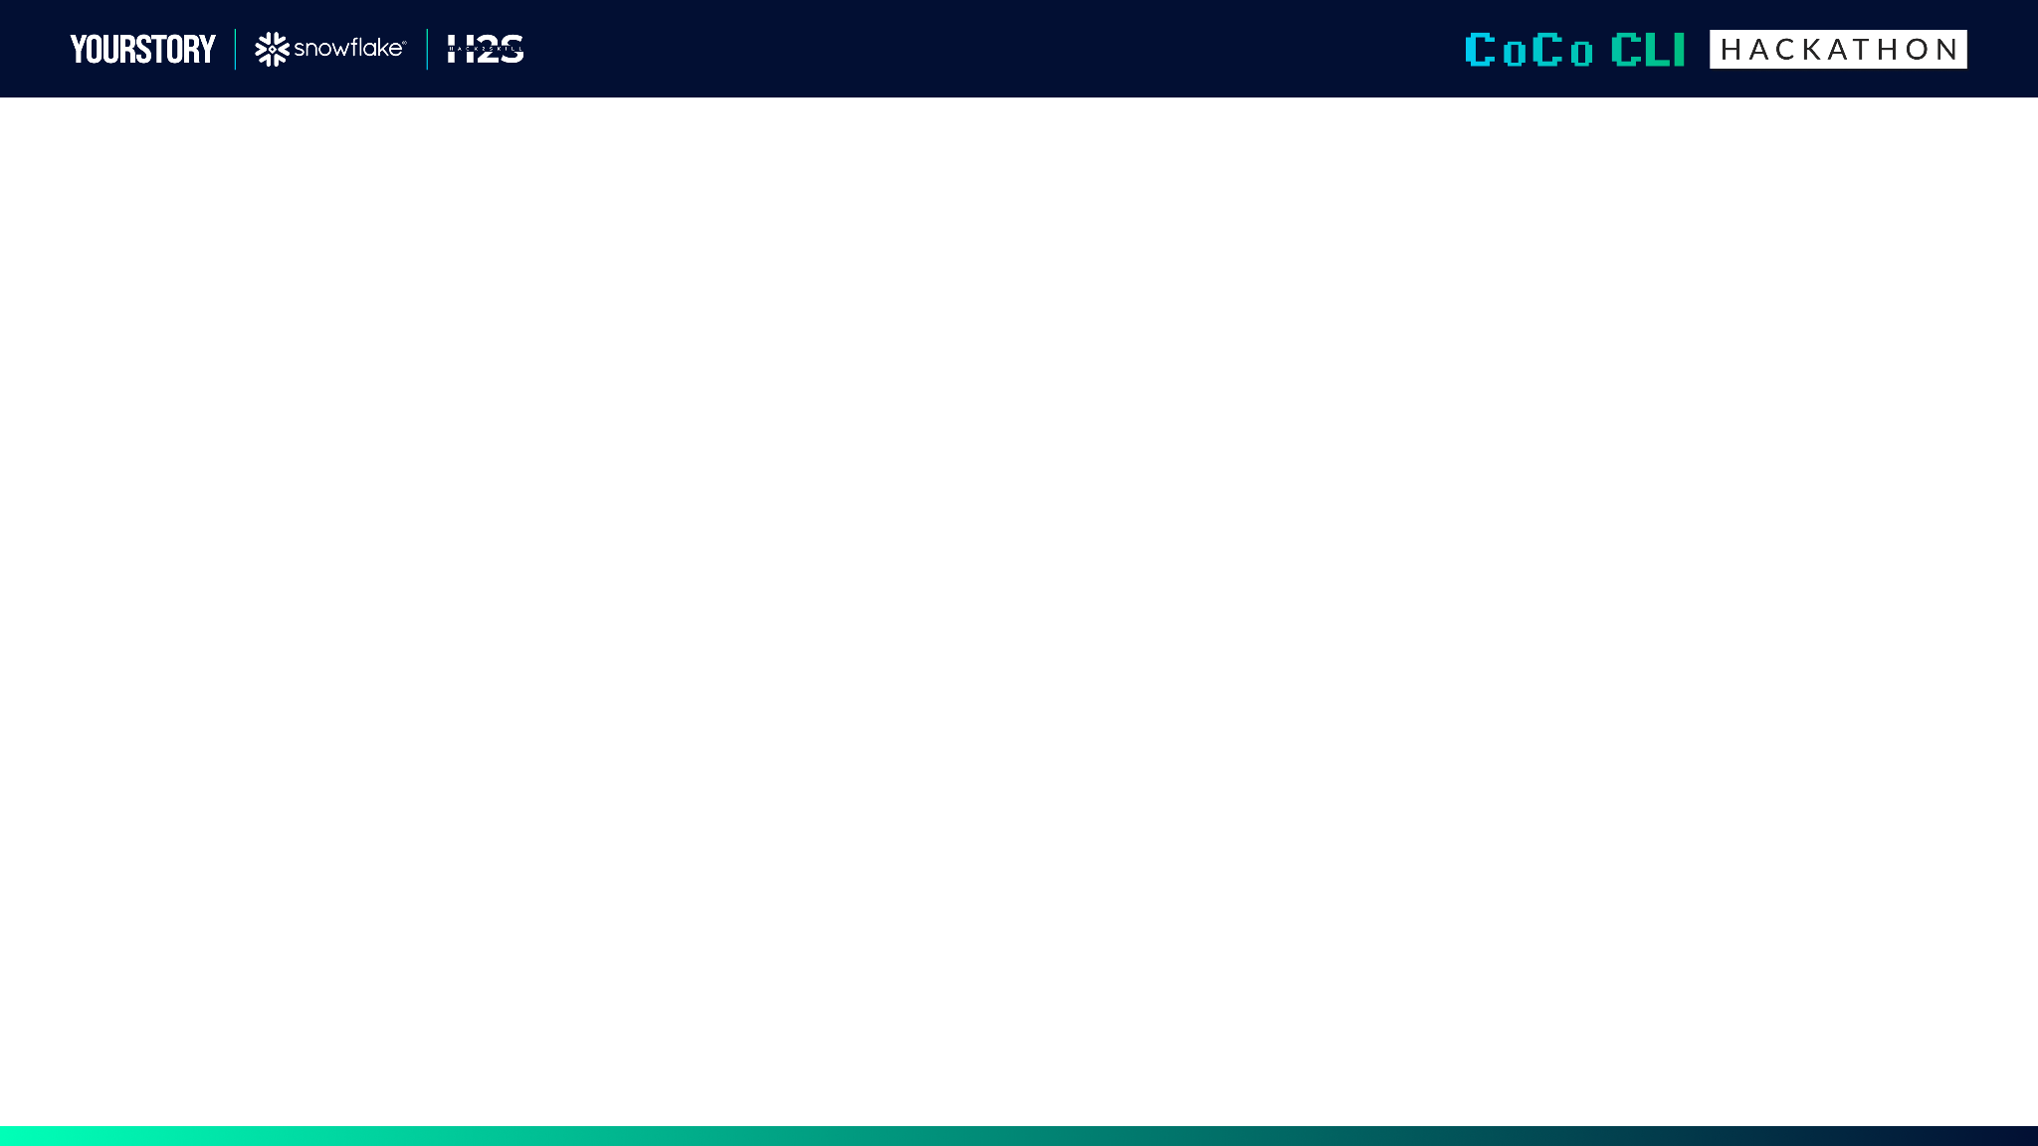
Submission Guidelines: (Things to add on the submission deck)
1. Problem Brief
What real business problem does this solve?
Who is the target user/persona?
What is the current pain point and how does this improve it?
Industry/domain context
2. Architecture Diagram
System design showing data flow
Which Cortex Code CLI skills are used and how they connect
Data sources (structured/unstructured)
How modular components plug together
3. Impact Statement
Measurable outcomes (time saved, accuracy improvement, etc.)
Scalability potential
How this extends beyond the demo
1. PROBLEM BRIEF & BUSINESS CONTEXT
• Real Business Problem: Global supply chains suffer millions in losses due to unmonitored supplier delays, port congestion, and inventory stockouts. Traditional ERP/BI tools only log incidents after line stoppage occurs.
• Target Persona: VP of Supply Chain, Operations Managers, Procurement & Logistics Directors.
• Current Pain Point: Manual cross-referencing between SQL database tables and unstructured logistics emails takes 2-5 days.
• Our Solution (Cortex-SupplyGuard): An autonomous cognitive agent powered by Snowflake CoCo CLI that scans warehouse tables, synthesizes unstructured logs using Snowflake Cortex AI, and executes policy-bounded transactional PO mitigations in < 3 seconds.

Slide 3
2. ARCHITECTURE DIAGRAM & MODULAR CoCo SKILLS
CoCo Agent Skills Implemented (SKILL.md standard):
1. data-anomaly-detector (skills/data_anomaly_detector/SKILL.md) Scans inventory burn rates, lead times, and shipping delays to compute composite risk scores (0-100).
2. cortex-reasoner (skills/cortex_reasoner/SKILL.md) Uses Snowflake Cortex AI (SNOWFLAKE.CORTEX.COMPLETE) to bridge structured metrics with unstructured incident logs (emails, port advisories) to deduce root cause & quantify financial risk ($).
3. action-executor (skills/action_executor/SKILL.md) Enforces financial policy guardrails (<$50k auto-approve), issues emergency POs, updates warehouse buffer stock, and logs audit trails.

Slide 4
3. WORKFLOW ORCHESTRATION & DUAL INTERFACES
• Multi-Step Orchestrator: Stateful state machine managing skill execution, decision branching (Auto-Approve vs. Human Escalation), and error recovery.
• Rich Interactive Terminal CLI: Powered by rich library featuring ANSI color traces, step progress bars, and interactive command prompt (python main.py --demo).
• Glassmorphism Web Dashboard: Live interactive web application featuring real-time metric cards, active workflow DAG step animations, and telemetry consoles (https://cortex-supplyguard-agent.vercel.app).

Slide 5
4. MEASURABLE BUSINESS IMPACT & OUTCOMES
• 85% MTTR Reduction: Reduces resolution time for supply chain bottlenecks from days of manual triage to under 3 seconds.
• $200,000+ Loss Avoidance: Proactively reroutes buffer stock and issues spot POs before assembly line stoppage occurs.
• 100% Policy Compliance: Enforces automated financial limits with full cryptographic audit logging.
• 100% Passing Test Suite: Fully verified with automated PyTest unit & integration tests.
Additional Slide

Slide 6
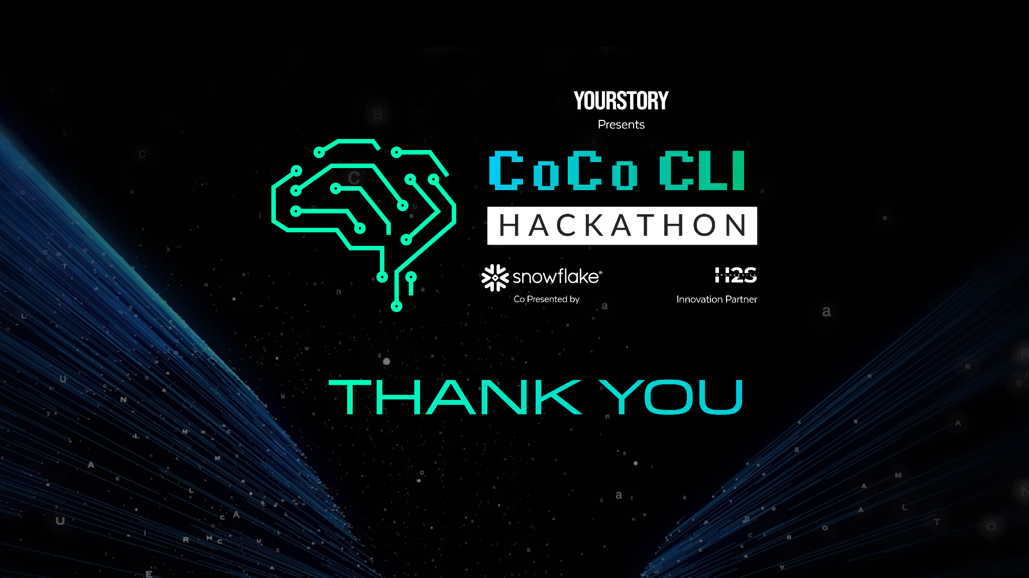
5. LIVE DEPLOYMENT & PRODUCTION LINKS
• Live Deployed Web Application: https://cortex-supplyguard-agent.vercel.app
• Public GitHub Repository: https://github.com/kholipha-ahmmad-al-amin/cortex-supplyguard-agent
Thank you! Team EquiSaaS BD | Kholipha Ahmmad Al-Amin & Jannatul Nayeem

